Slide 1

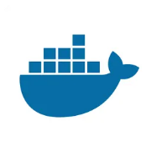
Modern Software Logistics
BUILD • SHIP • RUN • ANYWHERE
Presented By: Shahyan Ahmed Kiani

Slide 2
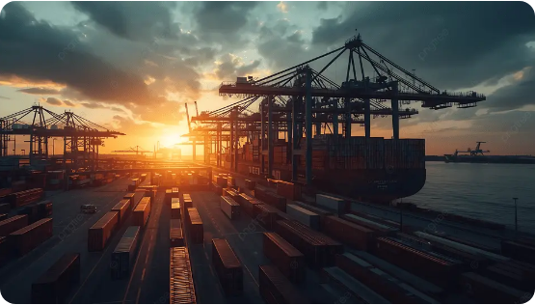

WHAT IS DOCKER?
The Platform for Containers
Docker is an open-source platform that automates the deployment of applications inside lightweight, portable containers.
It eliminates the "It works on my machine" problem by bundling software with all its dependencies into a single standardized unit.

Slide 3




THE ARCHITECTURE SHIFT
Traditional Virtualization
Containerization (Docker)
App A & App B
App A / App B / App C
Guest OS (Heavy)
HOST OS (Shared)
Hypervisor
Docker Engine
Host Infrastructure
Host OS Kernel
Hardware Virtualization: Multiple OS copies.
OS Virtualization: Shared kernel, lightweight.

Slide 4



IMAGES VS. CONTAINERS
Docker Image
Docker Container
The Blueprint: A read-only template containing the application code, libraries, and environment variables.
The Live Instance: A runnable instance of an image. It adds a writable layer on top of the image to store runtime changes.
Analogy: The Class in OOP or a Recipe.
Analogy: The Object in OOP or the Meal.

Slide 5
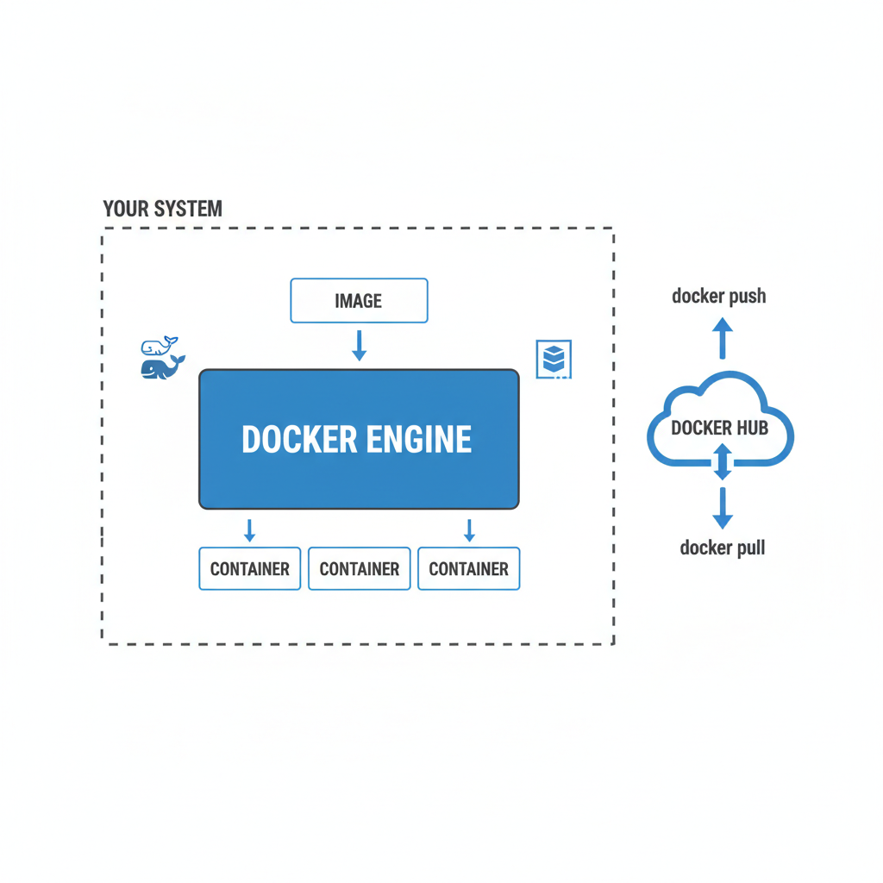
THE DOCKER ECOSYSTEM

Slide 6
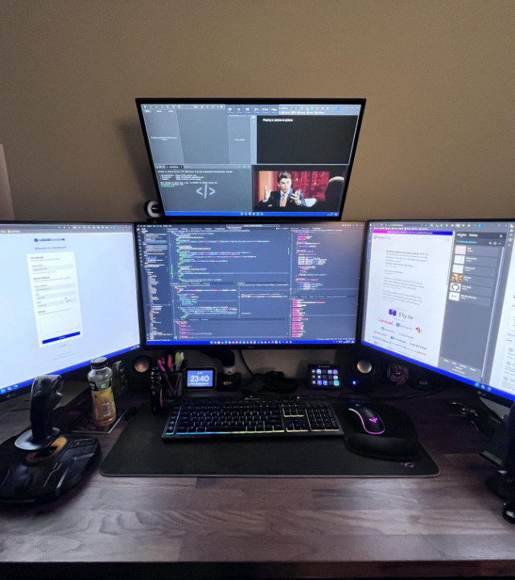
DOCKER DESKTOP
The GUI-based command center for developers. It simplifies the process of building, sharing, and running containers locally.
One-click setup for Win/Mac
Integrated Kubernetes support
Visual Dashboard for management

Slide 7



THE MASTER WORKFLOW
BUILD
SHIP
RUN
Create a Dockerfile describing your app environment.
Push the Image to Docker Hub or a Registry.
Pull and start the Container on any machine.

Slide 8
GETTING STARTED: KEY STEPS
Search: docker search [image_name]
Pull: docker pull [image_name]
Run: docker run [image_name]

Slide 9






THE ADVANTAGE MATRIX
Efficiency
Portability
Isolation
Seconds to start vs minutes for VMs. Shared resources mean more apps per server.
Package once, run anywhere. Works on your laptop, AWS, Azure, or private cloud.
Each container has its own network, storage, and processes. Enhanced security.

Slide 10
DEVELOPER IMPACT
Why Developers Love It
10X
It eliminates dependency hell. Every team member uses the exact same environment, reducing bugs by 30% on average.
Docker allows you to test microservices locally exactly as they would behave in production.
Faster Deployment

Slide 11



CRITICAL DOMAINS
CI / CD
Microservices
Cloud Native
Automated testing and continuous delivery in uniform environments.
Breaking monolithic apps into manageable, scalable services.
The foundation of Kubernetes and modern serverless computing.

Slide 12
Practicle
Complete Small Docker Project – Python Calculator App step by step.
✅ Create Project
✅ Write Python Calculator Code
✅ Create Dockerfile
✅ Build Docker Image
✅ Run Container
✅ Test
✅ Stop & Remove Container
✅ Optional: Push to Docker Hub

Slide 13
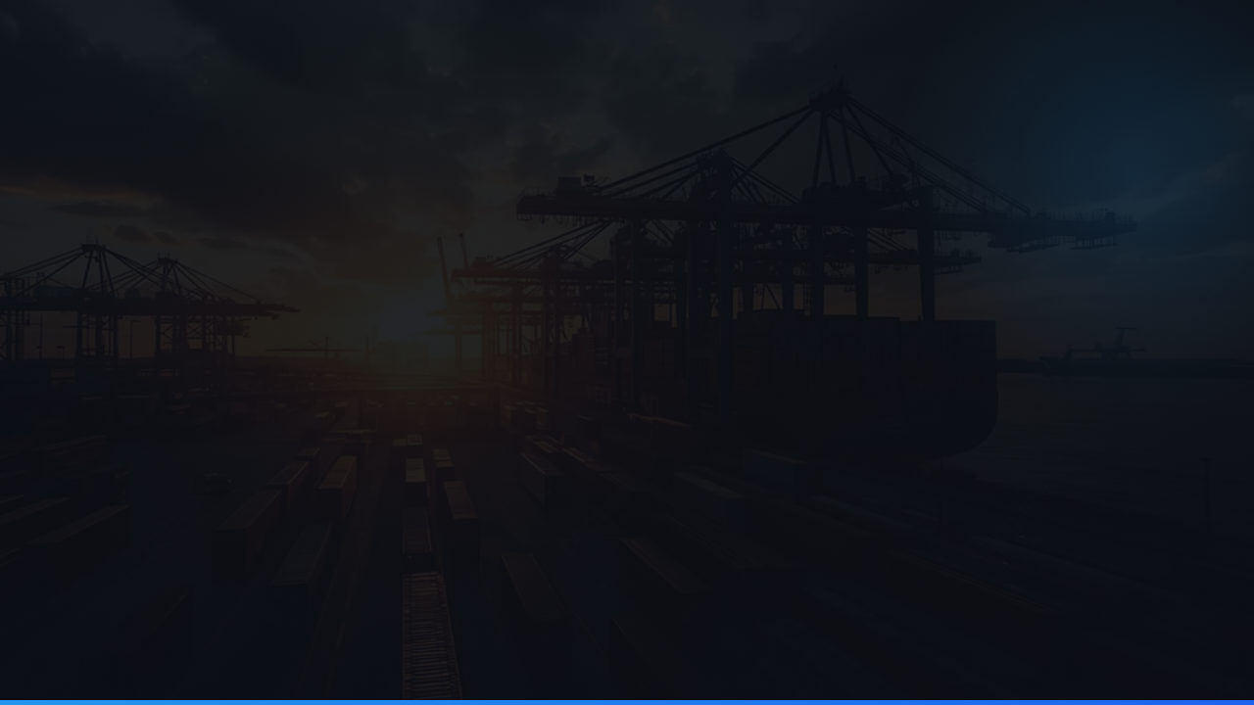
Questions?
Revolutionize your development workflow today.
Learn more at www.docker.com

Slide 14




IMAGE SOURCES
https://cdn.iconscout.com/icon/free/png-256/free-docker-logo-icon-svg-download-png-2285024.png?f=webp
Source: iconscout.com
https://png.pngtree.com/thumb_back/fw800/background/20251009/pngtree-sunset-over-busy-port-with-container-ship-cranes-and-rows-of-image_19805411.webp
Source: pngtree.com
https://preview.redd.it/how-do-you-devs-work-on-laptops-or-only-one-monitor-i-feel-v0-r8iipwujvnkc1.jpeg?auto=webp&s=5830ca3bd94e6c914890ccf08e11f2d43418c2e4
Source: www.reddit.com
https://dataspan.com/wp-content/uploads/2025/09/01-5-data-center-lighting-considerations.jpg
Source: dataspan.com

